Slide 1
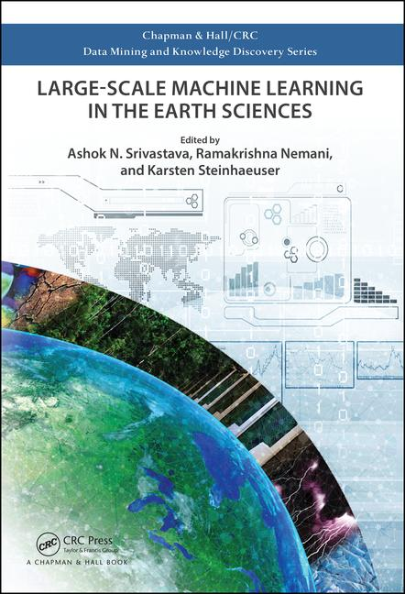
CRC Press
Part 2:
ML in Geosciences

Slide 2
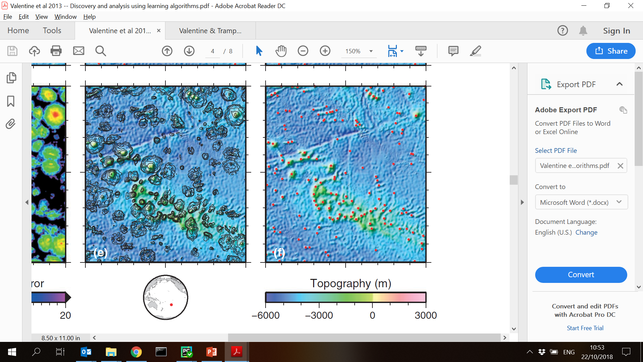
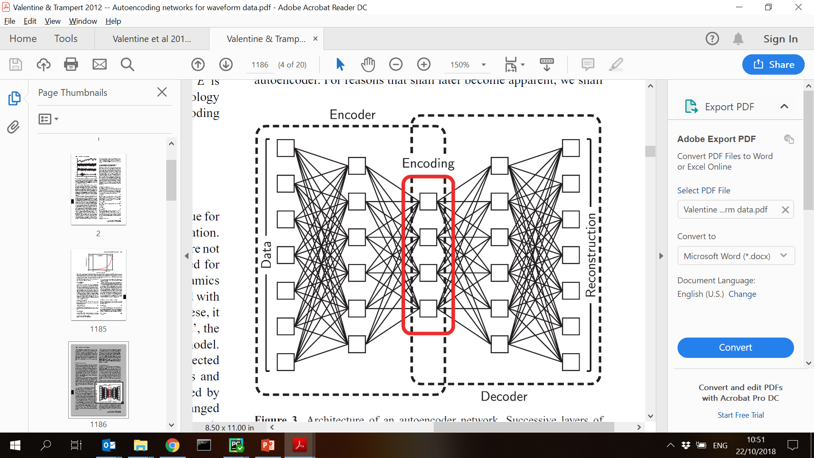
Examples in Geo
Valentine et al. (2012, 2013)

Slide 3
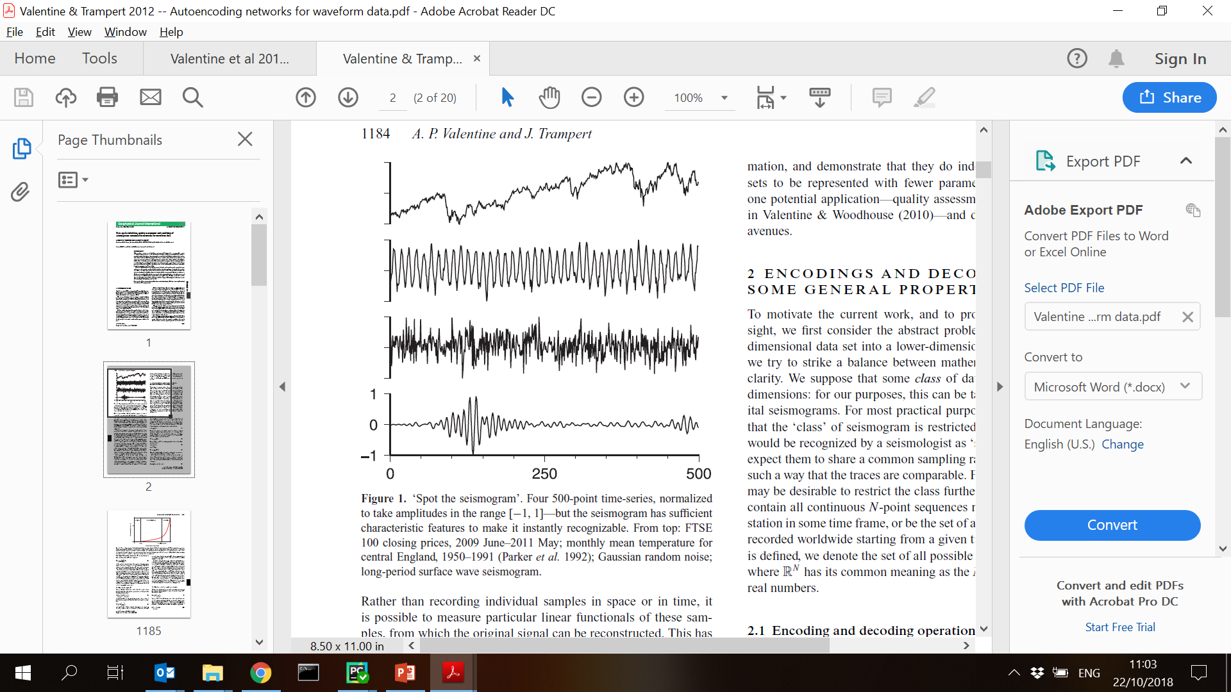
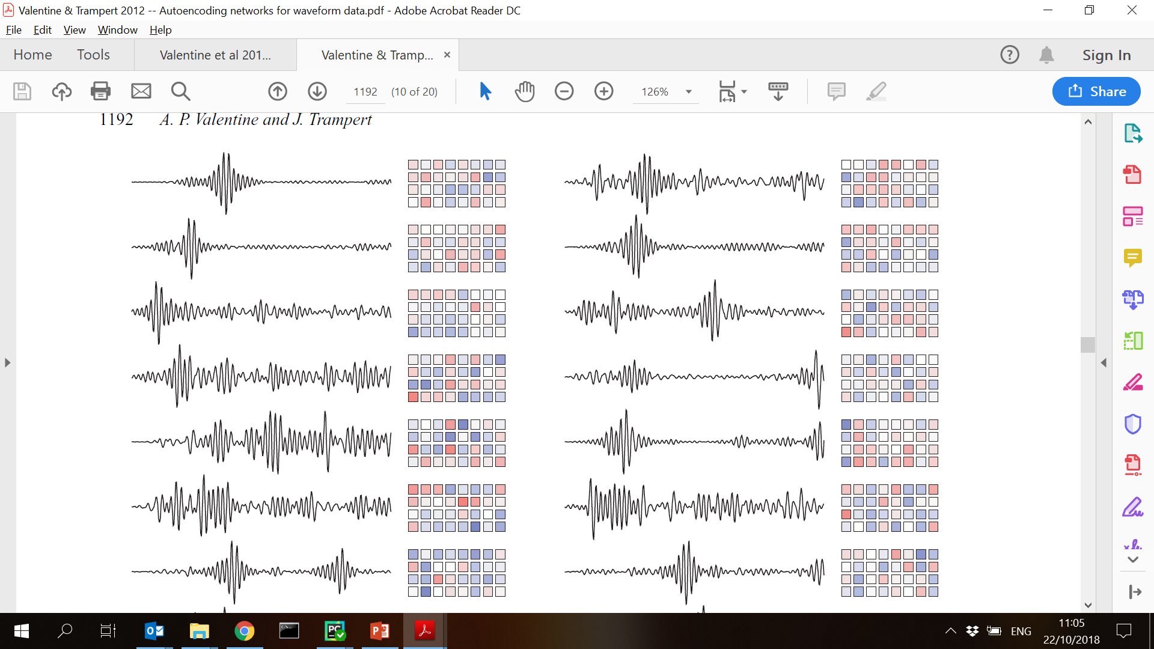
Examples in Geo
Valentine & Trampert (2012)

Slide 4
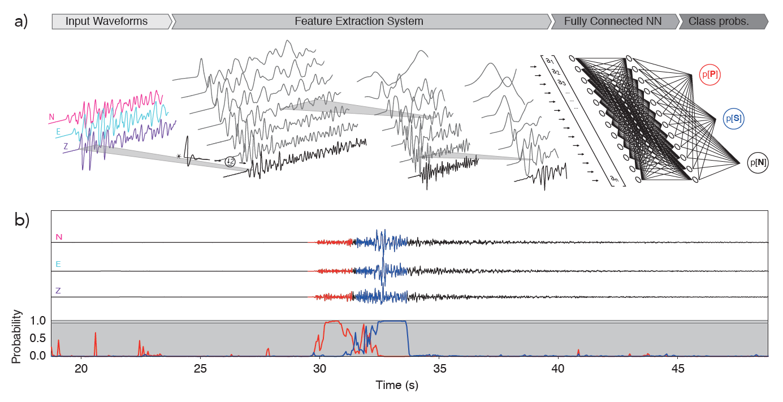
Examples in Geo
Ross et al. (2018)

Slide 5
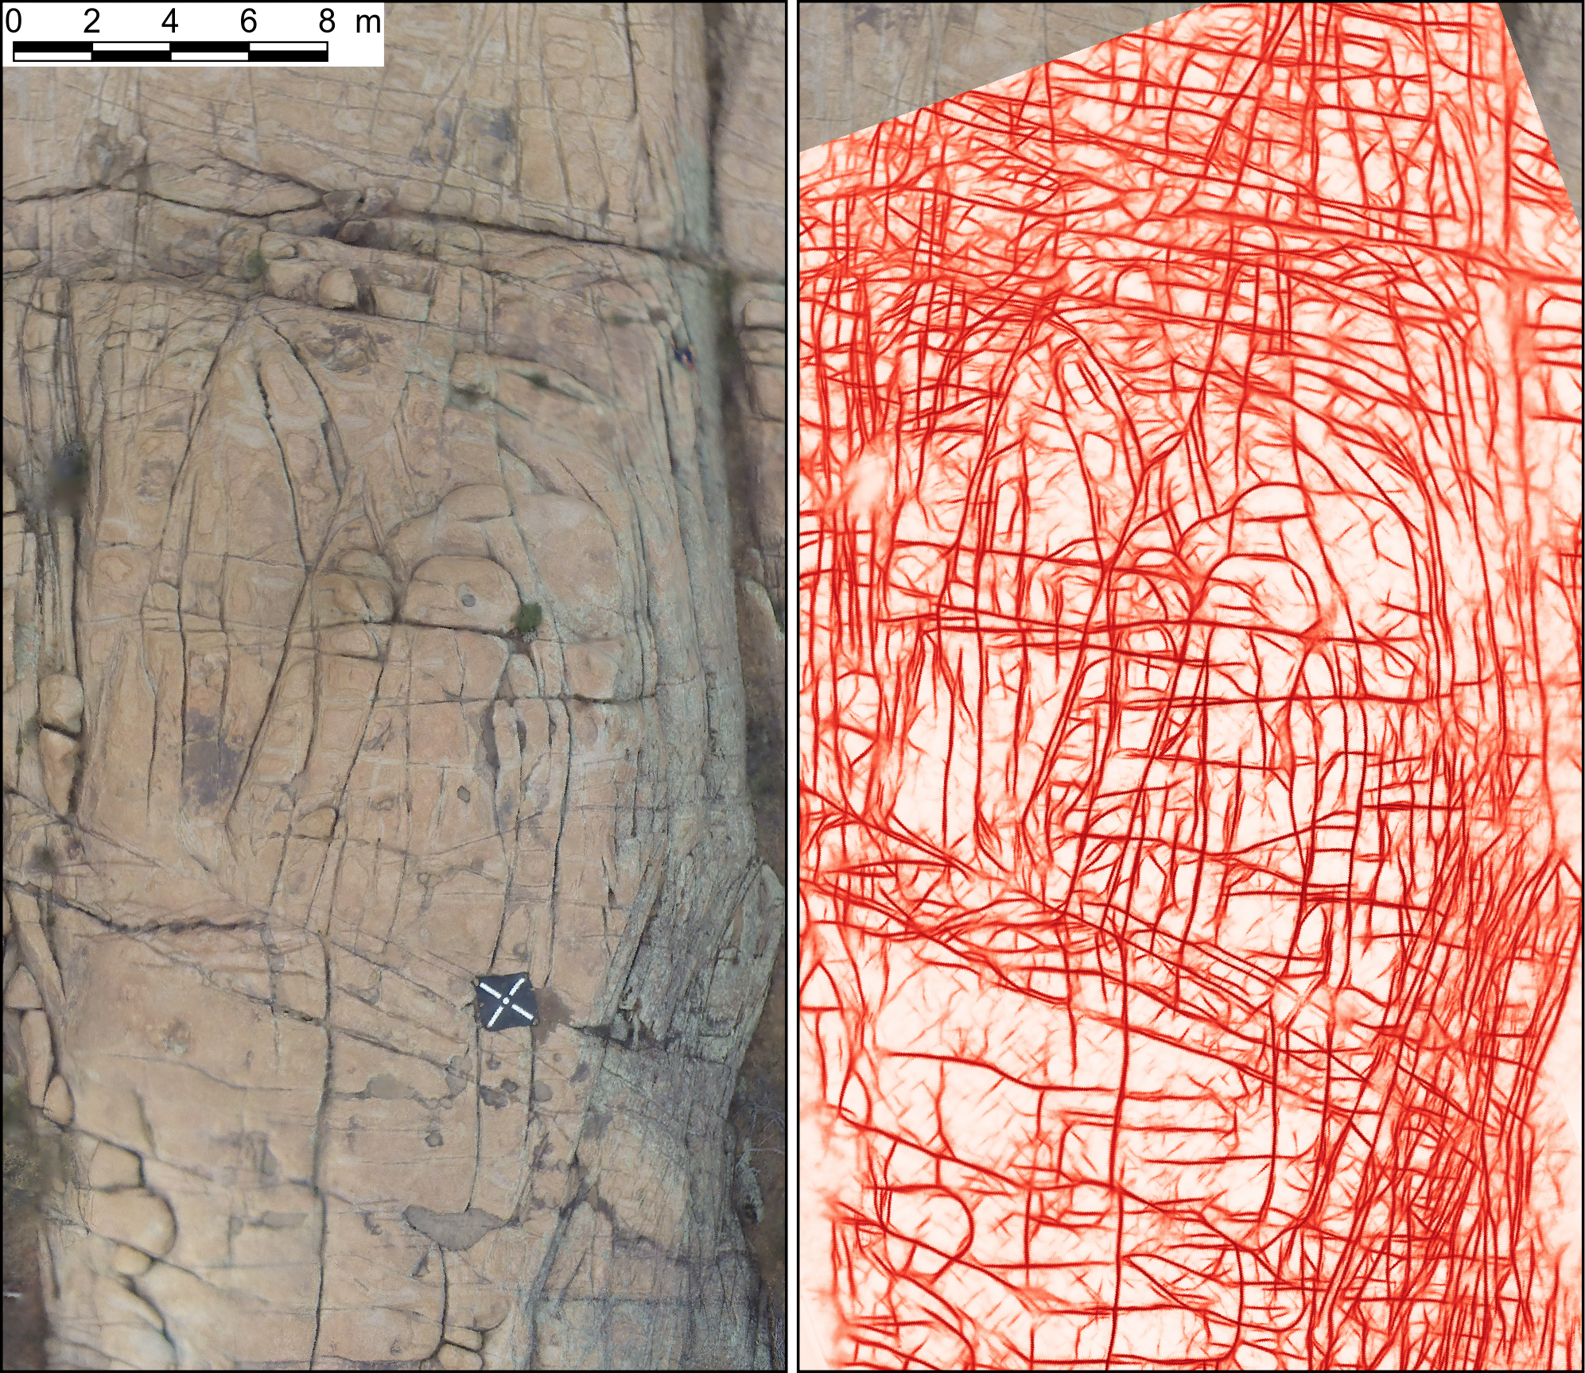
Examples in Geo
Matteo et al. (in prep) – FAULTS R GEMS

Slide 6
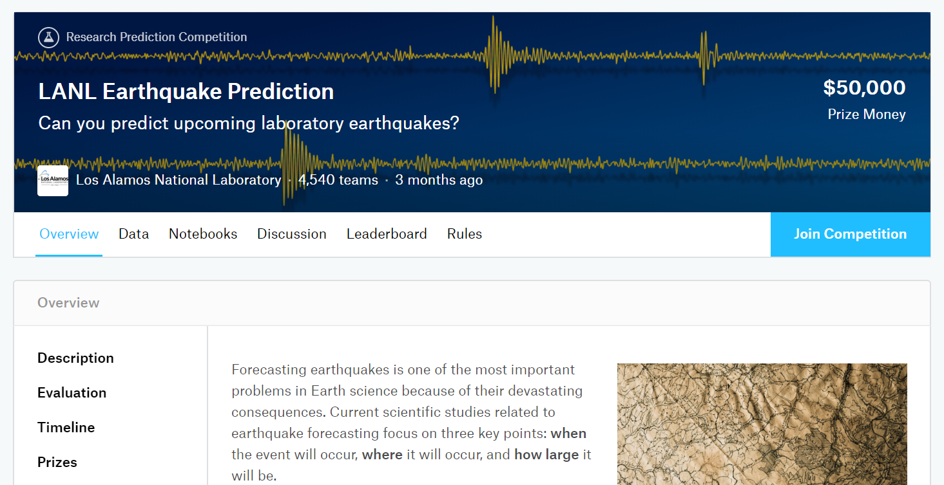
Examples in Geo
www.kaggle.com

Slide 7
The Workhorse: Convolution
Most Geoscientific problems involve analysis of time-series, images, or volumetric data
Fully-connected Neural Networks do not optimally leverage spatial correlations in the data
Convolutional Neural Networks (CNNs) do a better job at this

Slide 8

Is this the same cat?

Slide 9
Convolutional Neural Networks (CNN)
Rationale: signal correlations are mostly local

Slide 10
CNN Properties: Shift-Invariance

Slide 11
CNN Properties: Scale-“Invariance”

Slide 12
CNN Properties
Practically speaking, most CNNs are robust to:
Translation
Rotation
Scaling
Intuition: CNNs look for local patterns (“features”) in the data

Slide 13
CNN Architecture
Input
Convolution Layers
Fully-Connected Layers
Output
Feature Layer #1
Feature Layer #2
Feature Layer #3
Earthquake

Slide 14
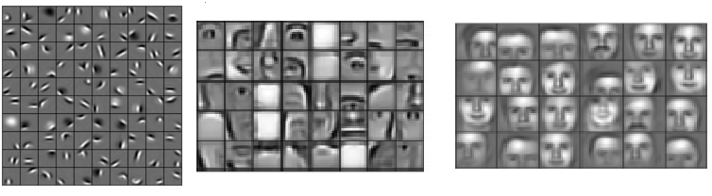
CNN Features
Layer 1
Layer 10
Layer 20
https://devblogs.nvidia.com

Slide 15
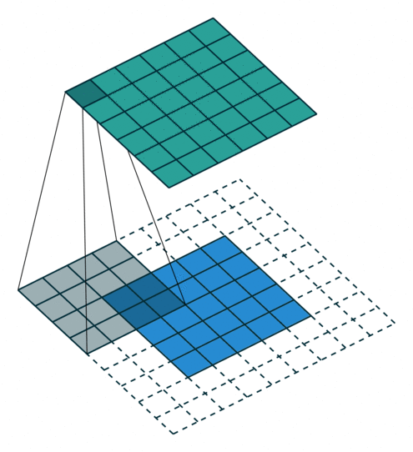
Basic CNN Mechanics
See https://github.com/vdumoulin/conv_arithmetic for more

Slide 16
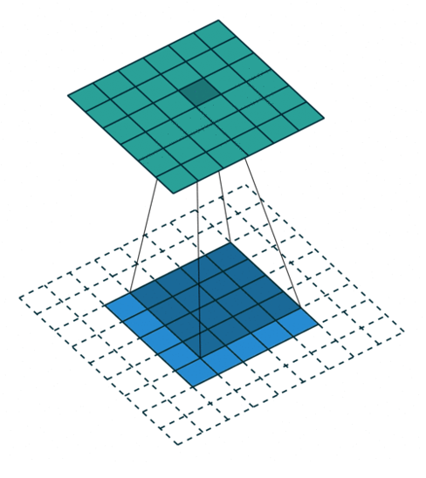
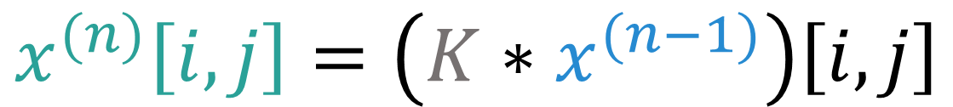
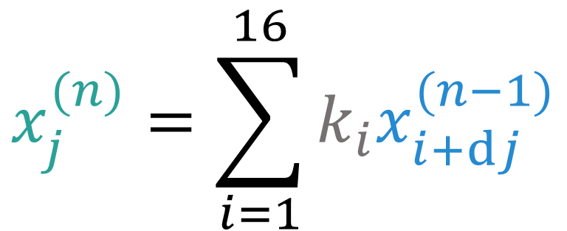
Basic CNN Mechanics
$$x_{j}^{(n)}=\sum_{i=1}^{16}{k_{i}x_{i+dj}^{(n−1)}}$$
$$x^{(n)}\left[i,j\right]=\left(K∗x^{(n−1)}\right)\left[i,j\right]$$

Slide 17
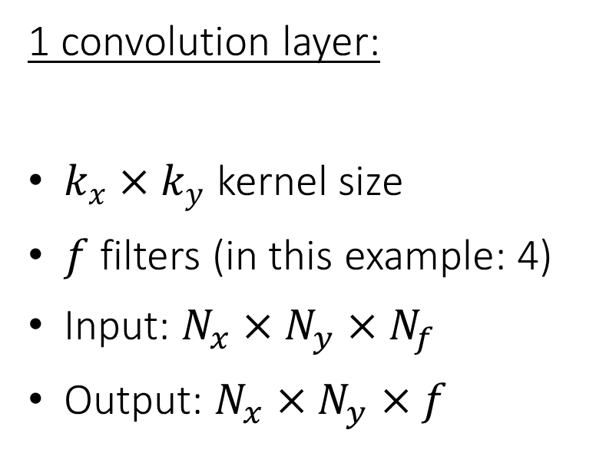
Basic CNN Mechanics
1 convolution layer:
$k_{x}×k_{y}$ kernel size
$f$ filters (in this example: 4)
Input: $N_{x}×N_{y}×N_{f}$
Output: $N_{x}×N_{y}×f$

Slide 18

Downsampling / pooling
Input data often contains redundant information
Incremental downsampling of the data: pooling

Slide 19

CNN Architecture

Slide 20
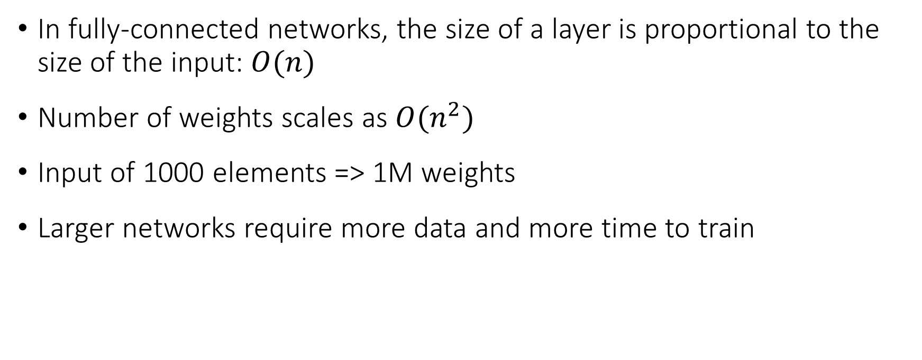
Small Network – Big Reach
In fully-connected networks, the size of a layer is proportional to the size of the input: $O(n)$
Number of weights scales as $O(n^{2})$
Input of 1000 elements => 1M weights
Larger networks require more data and more time to train

Slide 21
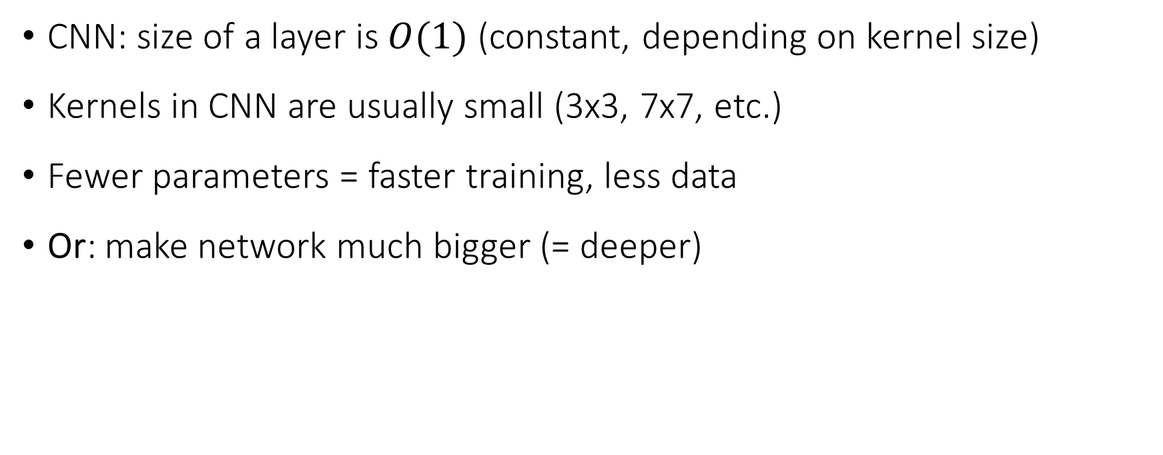
Small Network – Big Reach
CNN: size of a layer is $O(1)$ (constant, depending on kernel size)
Kernels in CNN are usually small (3x3, 7x7, etc.)
Fewer parameters = faster training, less data
Or: make network much bigger (= deeper)

Slide 22
Time for dirty hands again…

